Slide 1


Extended Source Inversion: a potential alternative to LF FWI W. Symes (Rice), M. Dolliazal, R. Nammour, P. Williamson (TotalEnergies)
Notes:
Good afternoon, or morning, or whatever time of day it is where you are. I will spend the next 15 minutes describing an inversion approach based on extended source modeling, a relatively new idea in this field that may provide a supplement to low-frequency FWI, or even an alternative when sufficient LF data is not available.

Slide 2
Agenda
Extended source inversion
Examples: synthetic 2D, marine 3D
Why it works
Limitations, Prospects

Slide 3
Example: transmission from single buried source
X (m)
Point source: z_{s} = 3 km, x_{s} = 3.5 km
Receiver array: z_{r} = 1 km, x_{r} = 2.0 – 6.0 km
Acoustic propagation, bulk modulus = 1.6 – 4.0 Gpa, density = 1 g/cm³
Source wavelet = bandpass filter pulse 1-2-7.5-12.5 Hz
Data = pressure traces, tapered at cable ends
Z (m)
GPa

Slide 4
FWI via Krylov-Gauss-Newton (like iterated LS migration), with CG inner loop, initial model = homogeneous
20 KGN iteration (@ 20 CG iterations) using correct source (not updated) stagnates, fails to fit later arrivals
physical (correct) source
Estimated BulkMod - 20 KGN FWI iterations
Data misfit

Slide 5
Surface source extension – source energy spread over surface z=z_{s}
With proper extended source, can fit any data, regardless of velocity!
Example: homogeneous model, source energy at z=z_{s}, x=1.5 – 5.5 km, update source using CG to best fit data (but no velocity update!!!)
Extended source – constructed to best fit lens data with homogeneous velocity
Data misfit, same color scale as previous slide

Slide 6
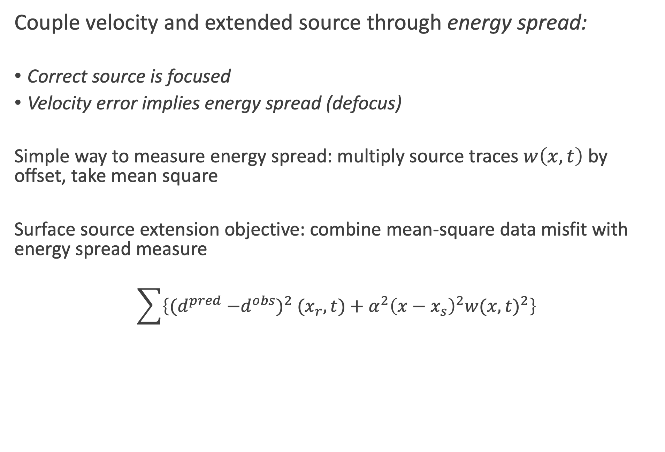
Couple velocity and extended source through energy spread:
Correct source is focused
Velocity error implies energy spread (defocus)
Simple way to measure energy spread: multiply source traces $w\left(x,t\right)$ by offset, take mean square
Surface source extension objective: combine mean-square data misfit with energy spread measure
$$\sum{\left\{(d^{pred}{−d^{obs})}^{2}{(x}_{r},t)+α^{2}{\left(x−x_{s}\right)}^{2}{w(x,t)}^{2}\right\}}$$

Slide 7
Agenda
Extended source inversion
Examples: synthetic 2D, marine 3D
Why it works
Limitations, Prospects

Slide 8
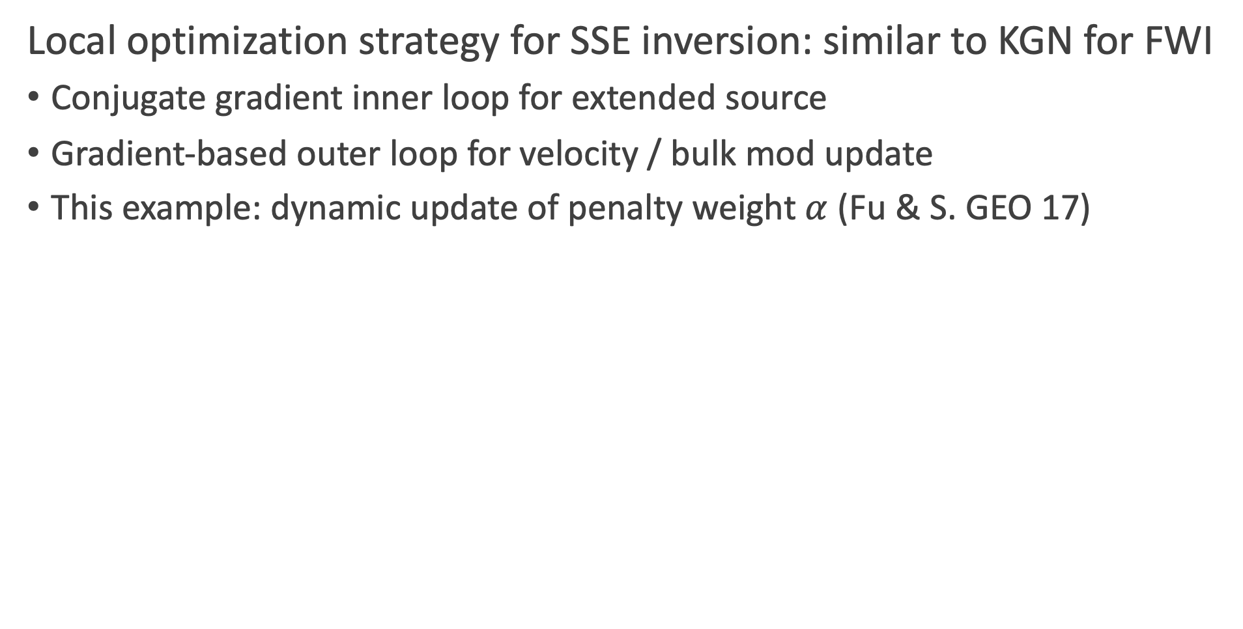
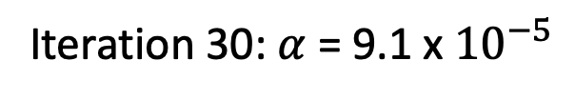
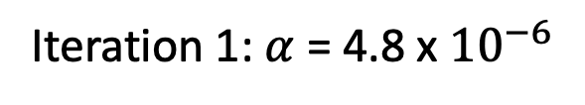
Local optimization strategy for SSE inversion: similar to KGN for FWI
Conjugate gradient inner loop for extended source
Gradient-based outer loop for velocity / bulk mod update
This example: dynamic update of penalty weight $α$ (Fu & S. GEO 17)
Iteration 1: $α$ = 4.8 x ${10}^{−6}$
Iteration 30: $α$ = 9.1 x${ 10}^{−5}$
Bulk Modulus Updates

Slide 9
Extended source estimates focus as inversion proceeds
Converge to point source as velocity kinematics improve
Iteration 1
Iteration 7
Iteration 29

Slide 10
SSE inversion as model builder: use final velocity as initial model for FWI
30th iteration of SSE = initial model for 18 iterations of KGN FWI
Final RMS data misfit = 1.2% of data RMS
Final FWI bulk mod
Target bulk mod

Slide 11
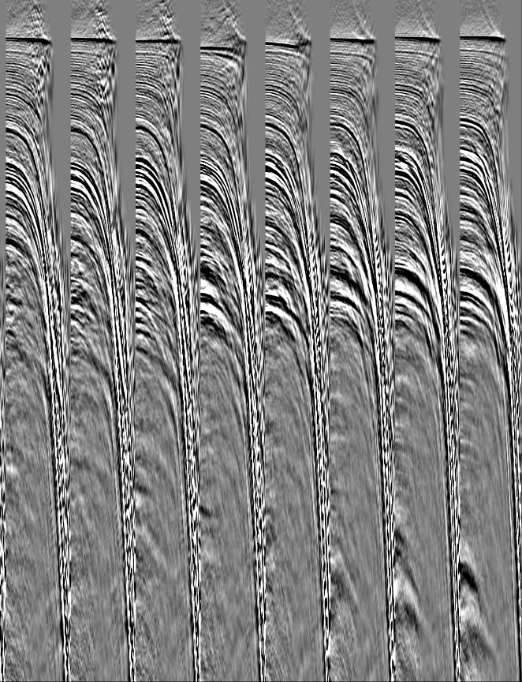
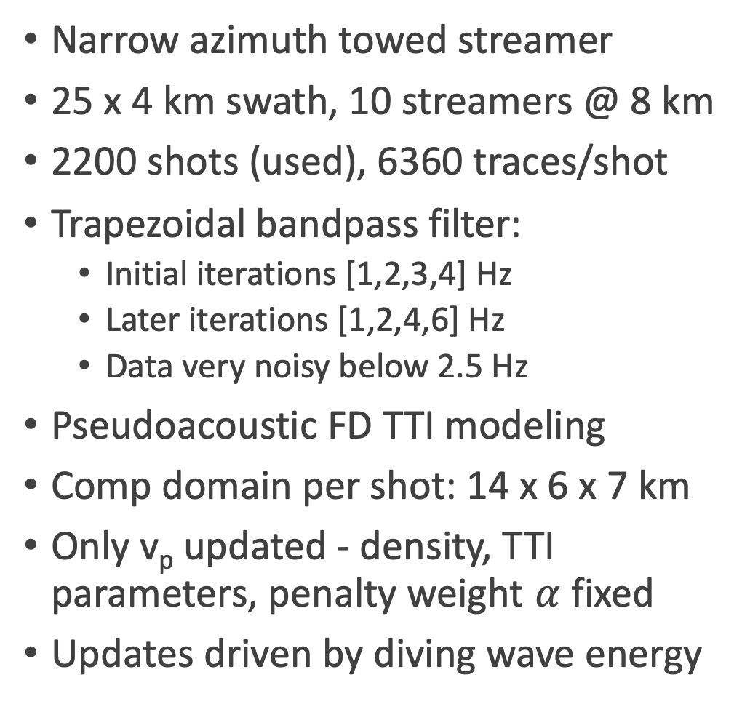
Application to Marine Survey
Kirchhoff gathers at initial v_{p} =
detuned “good” FWI model
Narrow azimuth towed streamer
25 x 4 km swath, 10 streamers @ 8 km
2200 shots (used), 6360 traces/shot
Trapezoidal bandpass filter:
Initial iterations [1,2,3,4] Hz
Later iterations [1,2,4,6] Hz
Data very noisy below 2.5 Hz
Pseudoacoustic FD TTI modeling
Comp domain per shot: 14 x 6 x 7 km
Only v_{p} updated - density, TTI parameters, penalty weight $α$ fixed
Updates driven by diving wave energy

Slide 12
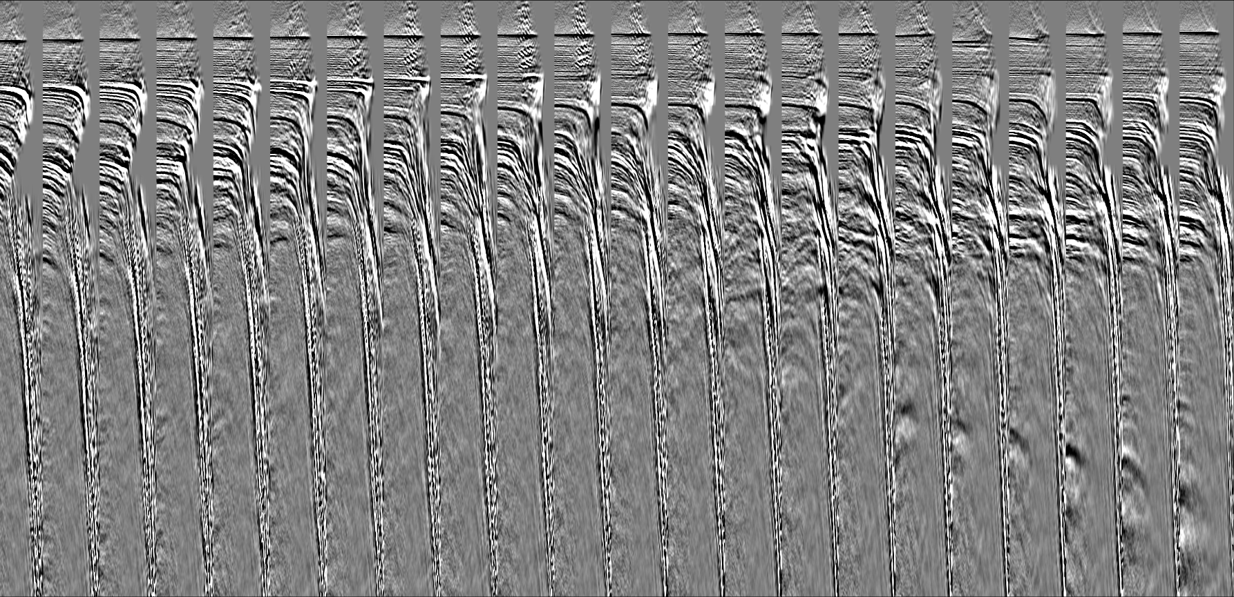
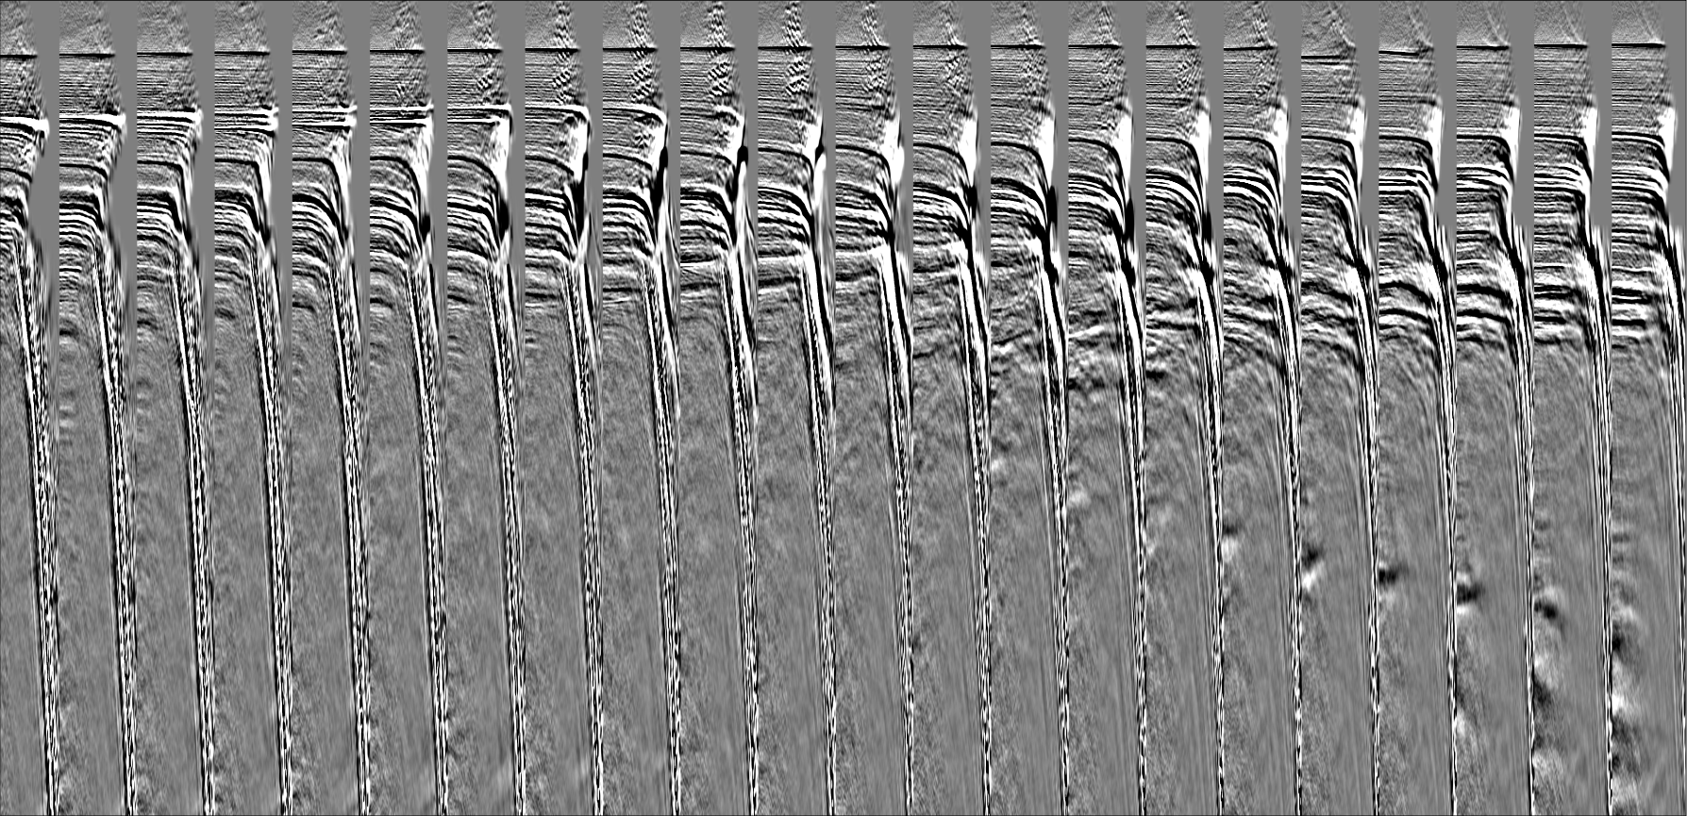
127 FWI iterations
127 SSE iterations

Slide 13
Agenda
Extended source inversion
Examples: synthetic 2D, marine 3D
Why it works
Limitations, Prospects

Slide 14
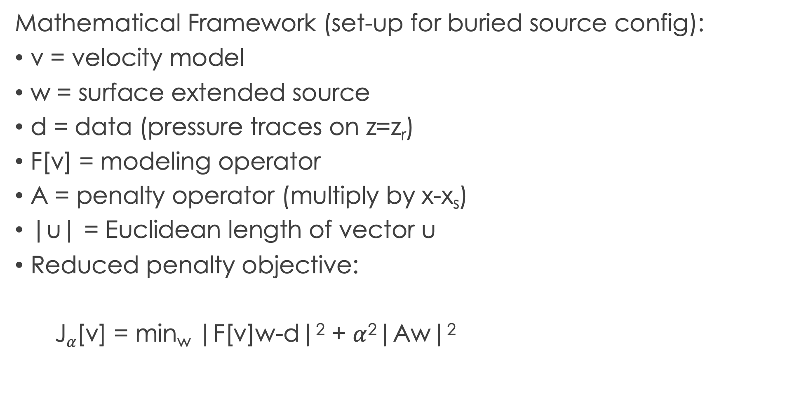
Mathematical Framework (set-up for buried source config):
v = velocity model
w = surface extended source
d = data (pressure traces on z=z_{r})
F[v] = modeling operator
A = penalty operator (multiply by x-x_{s})
|u| = Euclidean length of vector u
Reduced penalty objective:
J$α$[v] = min_{w} |F[v]w-d|² + $α$²|Aw|²

Slide 15
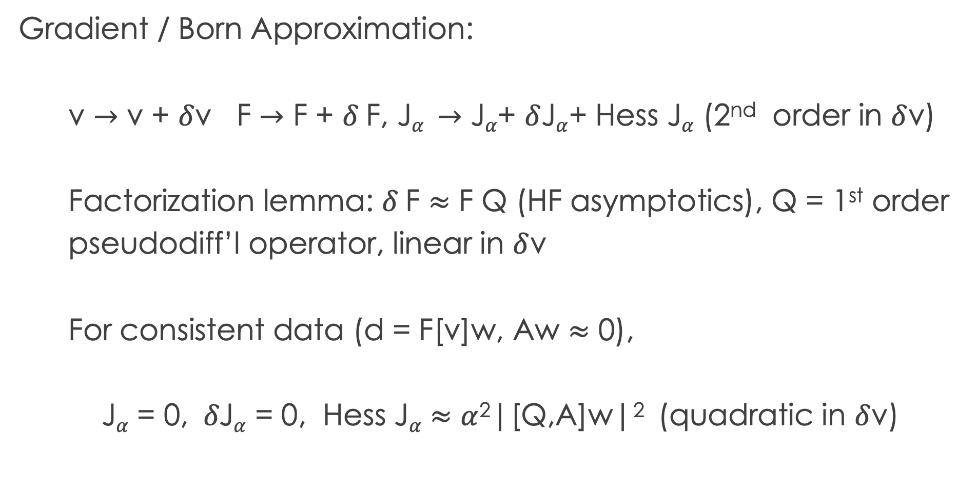
Gradient / Born Approximation:
v $→$ v + $δ$v F $→$ F + $δ$F, J$α →$ J$α$+ $δ$J$α$+ Hess J$α$ (2nd order in $δ$v)
Factorization lemma: $δ$F $≈$ F Q (HF asymptotics), Q = 1st order
pseudodiff’l operator, linear in $δ$v
For consistent data (d = F[v]w, Aw $≈$ 0),
J$α$ = 0, $δ\text{J}α$ = 0, Hess J$α$ $≈$ $α$²|[Q,A]w|² (quadratic in $δ$v)

Slide 16
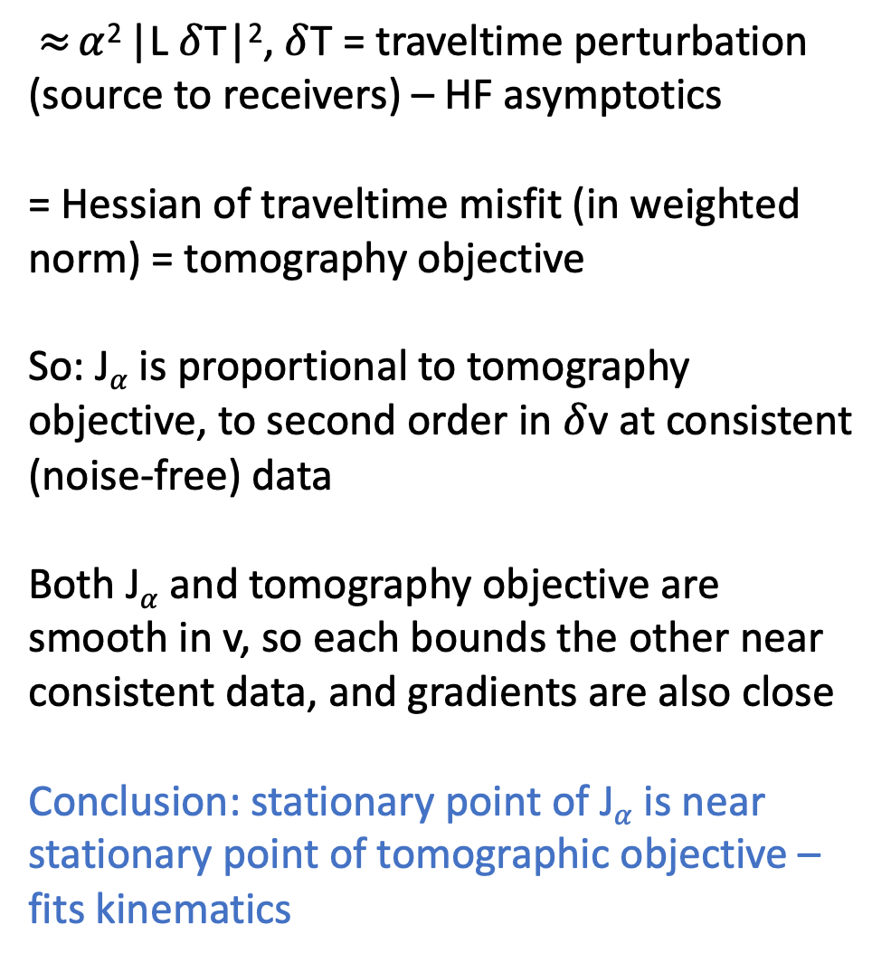
$≈$ $α$² |L $δ$T|², $δ$T = traveltime perturbation (source to receivers) – HF asymptotics
= Hessian of traveltime misfit (in weighted norm) = tomography objective
So: J$α$ is proportional to tomography objective, to second order in $δ$v at consistent (noise-free) data
Both J$α$ and tomography objective are smooth in v, so each bounds the other near consistent data, and gradients are also close
Conclusion: stationary point of J$α$ is near stationary point of tomographic objective – fits kinematics
Conceptual Cartoon
Hess J, TT obj = red, J = blue, TT obj = green, FWI obj = magenta

Slide 17
Agenda
Extended source inversion
Examples: synthetic 2D, marine 3D
Why it works
Limitations, Prospects

Slide 18
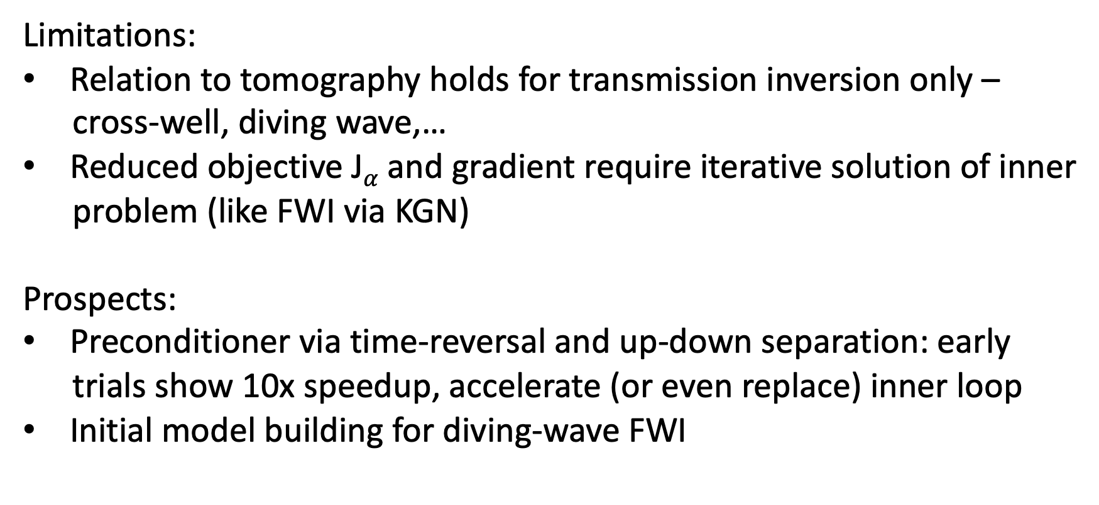
Limitations:
Relation to tomography holds for transmission inversion only –
cross-well, diving wave,…
Reduced objective J$α$ and gradient require iterative solution of inner
problem (like FWI via KGN)
Prospects:
Preconditioner via time-reversal and up-down separation: early
trials show 10x speedup, accelerate (or even replace) inner loop
Initial model building for diving-wave FWI

Slide 19
Authors thank TotalEnergies for permission to present this work…
and you, for listening!
Questions welcome!

